Slide 1

Community Development Project
BUILDING A SELF-RELIANT SOCIETY
PRESENTED BY: SUBHAM RAJ
DATE: 02OCT2023
REG.: 12203310

Slide 2
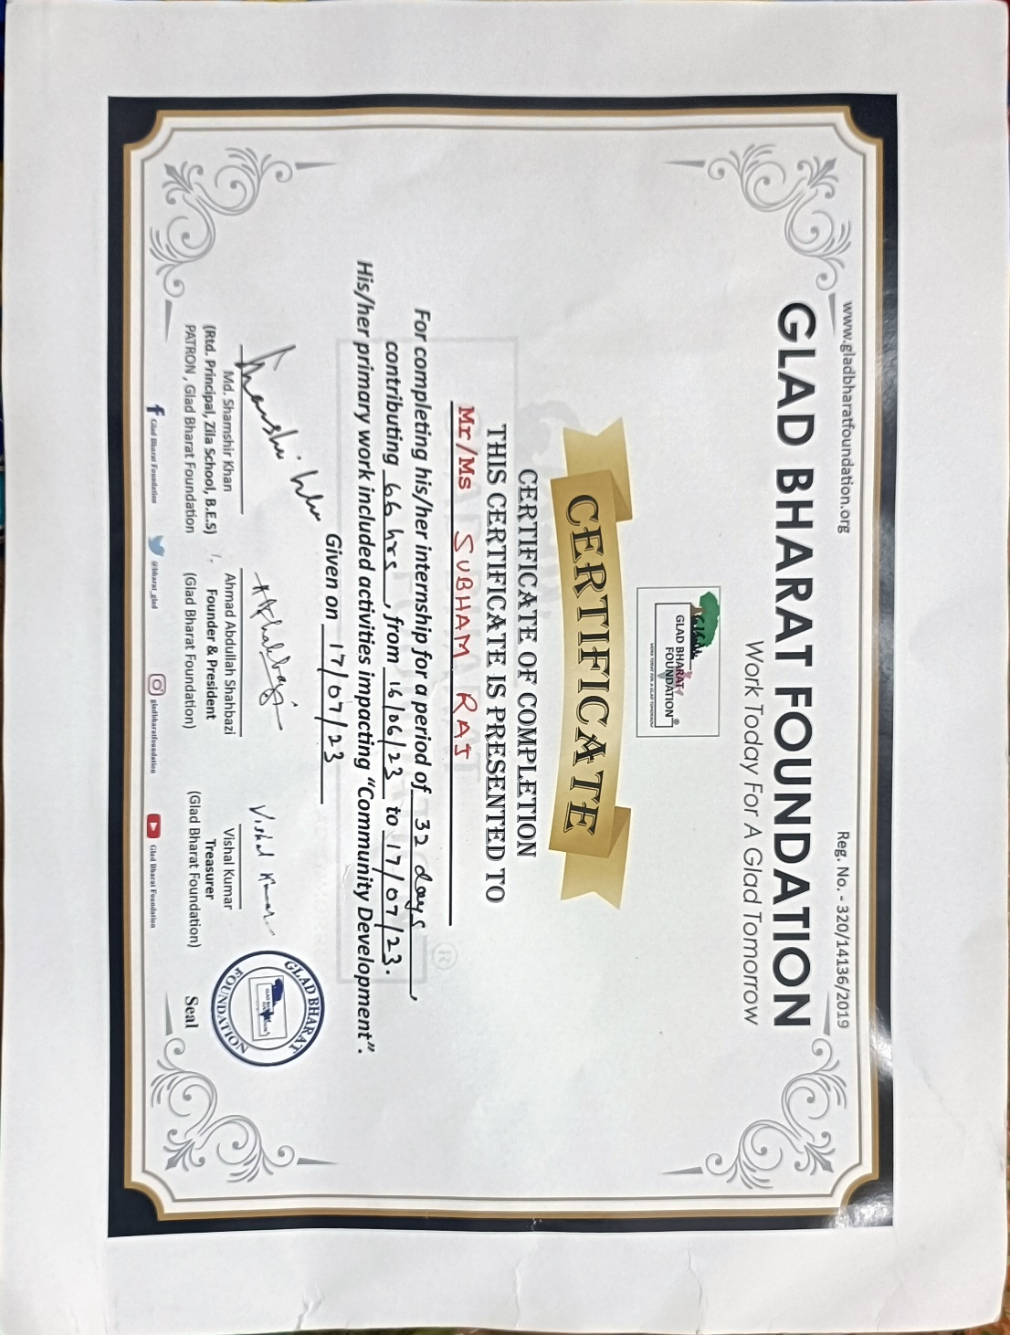

Slide 3

INTRODUCTION
“Building a Self-Reliant Society” is a community development initiative and this is initiated by Glad Bharat
Foundation. The organization works to develop a Self-Reliant Society by creating local leadership.
The Key Indices of the organization:
1. Education
2. Environment
3. Health
4. Livelihood

Slide 4
Based on these key indices we worked on 5 tools(initiatives):
Glad Bharat Paathshala
Green Campus
Flagship Initiative: PAD-ATM
Skill at School
Main Bhi Samarth Hu
Under the four key indices, we worked at seven project locations where we engaged directly with the communities of women, children, and adolescent girls to implement the above five initiatives.

Slide 5
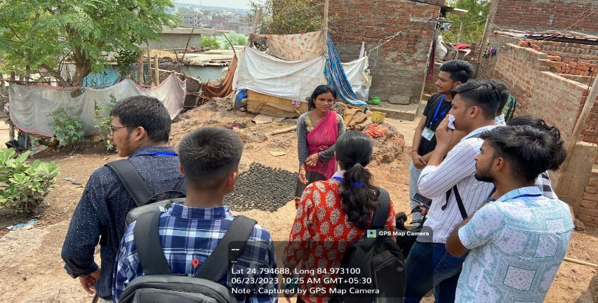
Problem Identification and The Cause of the Problem
We took around a few survey from different homes there in a urban slum area:
No Government Interaction
No Basic Education among elders
Low resource Availability
Ignorance from Govt. Officials
Low Menstrual Hygiene
Unemployment
Our survey concluded that the causes of all the problems faced by these less privileged sections are neglected areas, Lack of Awareness, Basic Education, and Less Interaction with government bodies. They were having a blockage in taking steps for their basic rights.

Slide 6
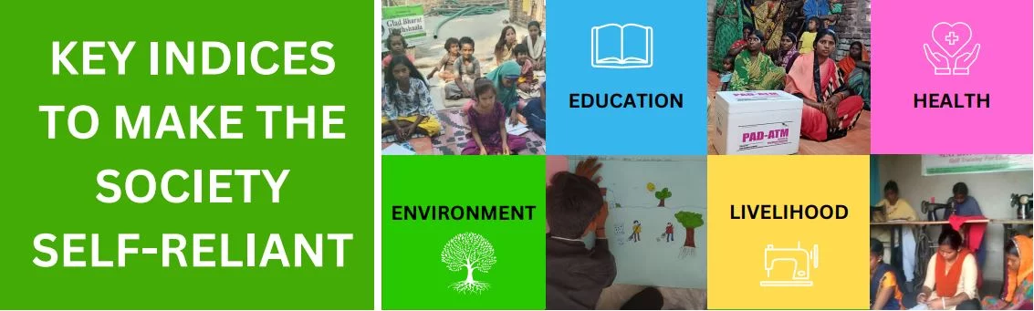
Objective to be achieved
As I have mentioned above, the vision of our organization is to make society self-reliant by developing local leadership at every level of society to improve the present condition of education, environment, health, and livelihoods.

Slide 7
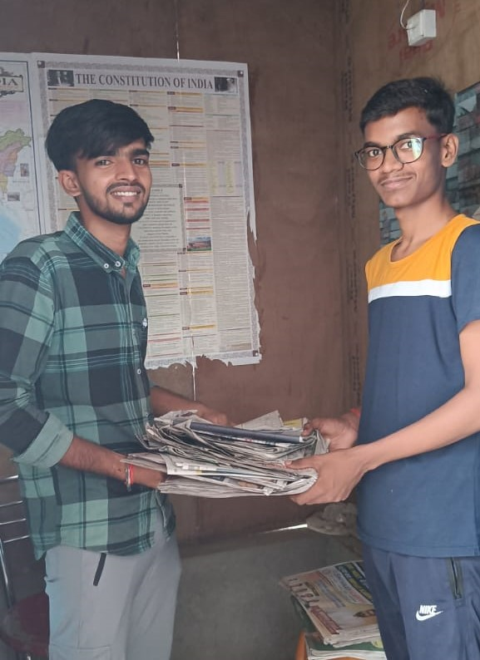
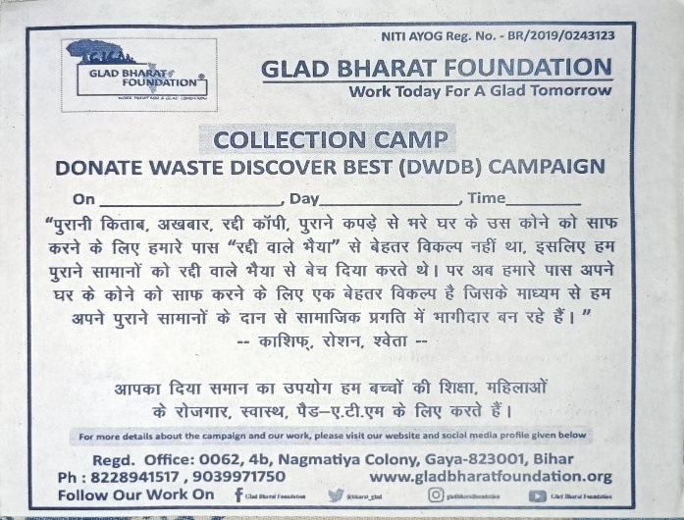
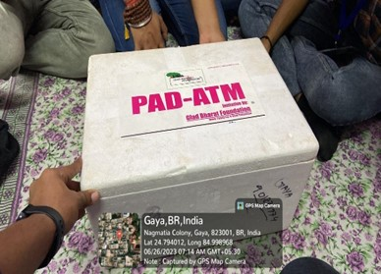
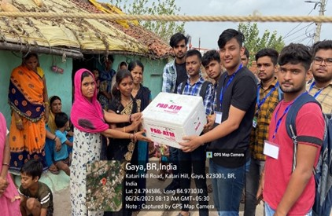
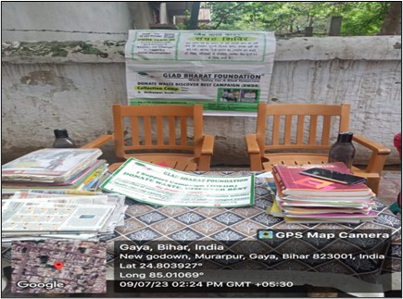
Various Steps Taken to Achieve the Foundation Objective
1. DWDB(Donate Waste Discover Best)
DWDB is a phase that demonstrates how urban residents participate in the development of less fortunate individuals.
2. PAD-ATM
The Pad-ATM is the Flagship initiative which provides easy accessibility of sanitary pads at an affordable price to women and adolescent girls living in rural remote areas, urban slums, and girls studying at under-resourced schools.

Slide 8
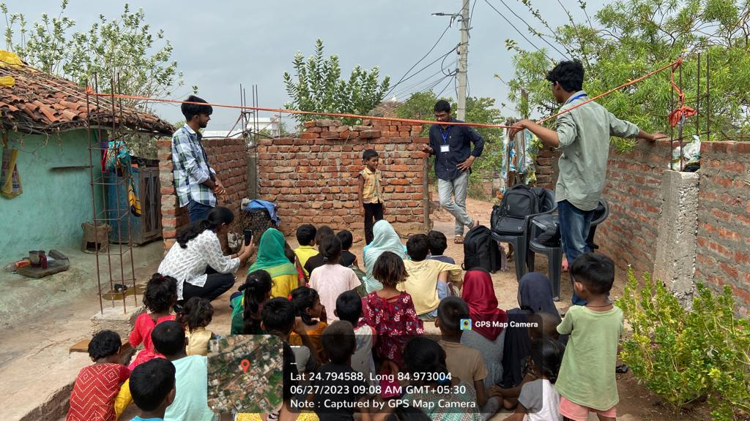
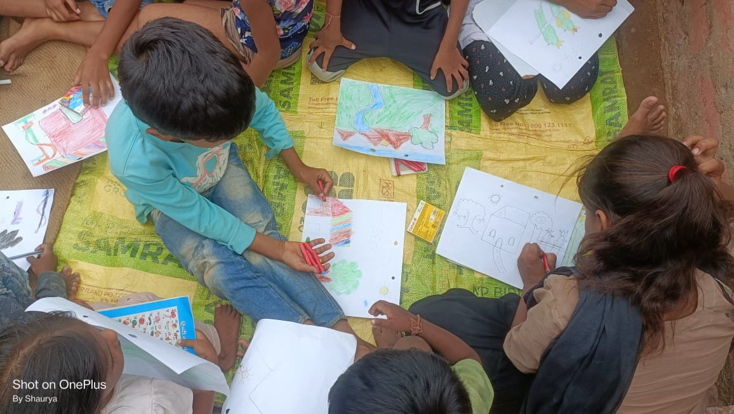
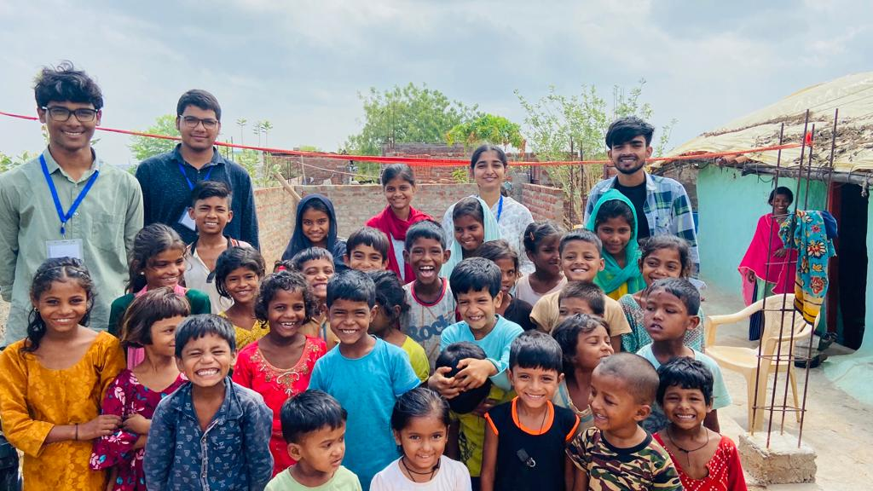
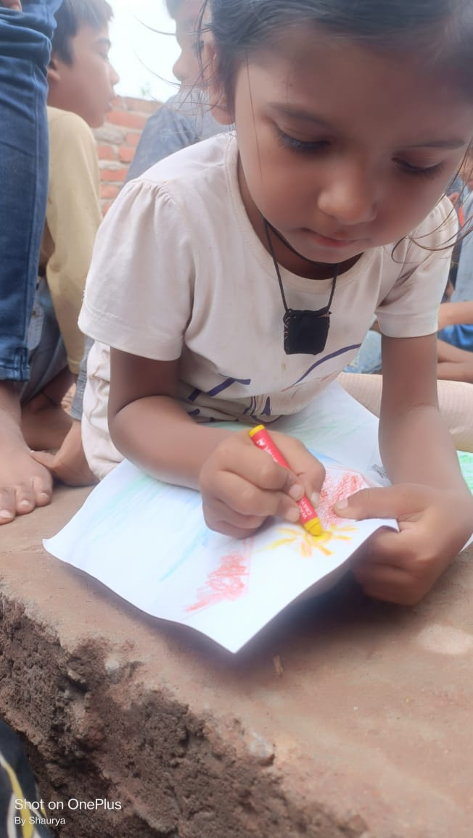
3. Glad Bharat Pathshala
As part of our Glad Bharat Pathshala Initiative, we organized a summer camp for children in the urban slum of Katari Hill, Gaya, on July 27-28, 2023. Through activities like singing, poetry, dance, storytelling, and sketching, we aimed to foster a joyful environment.

Slide 9
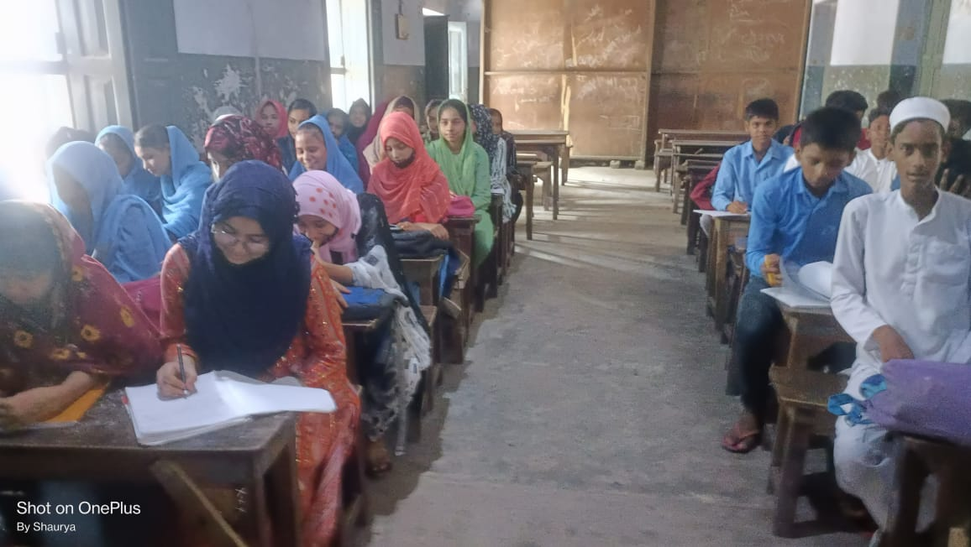
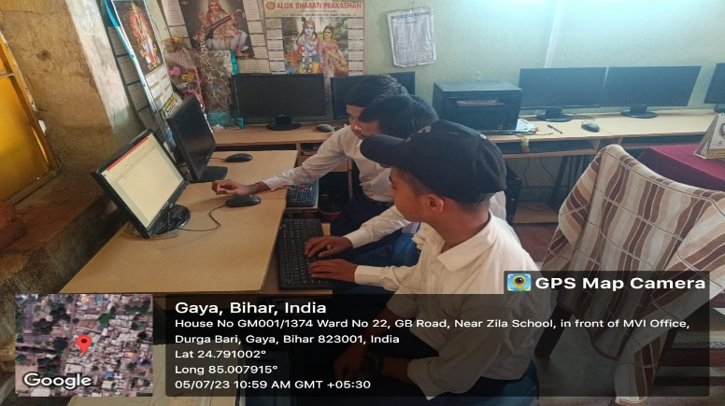

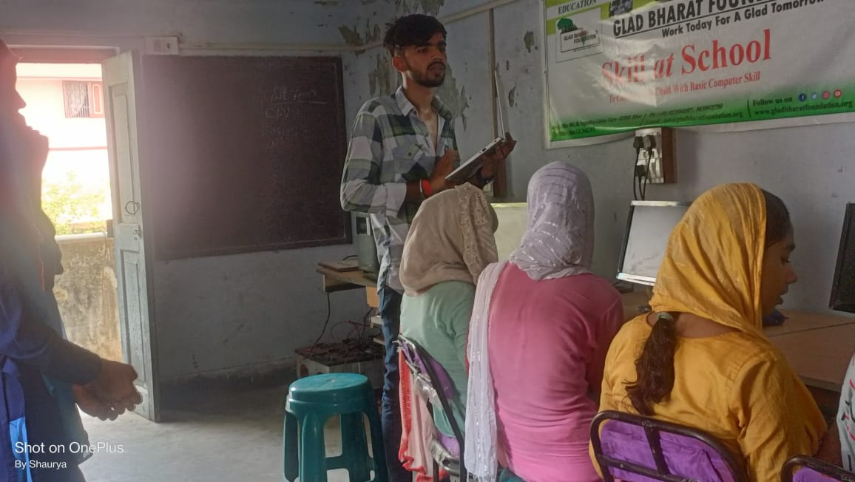
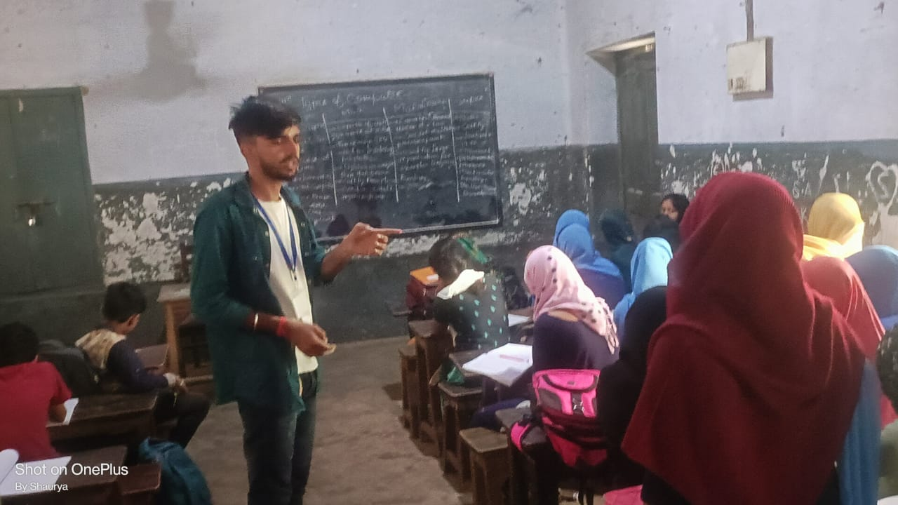
4. Skill At School
We extended our efforts to schools in less-developed areas, providing vital computer fundamentals, including proficiency in Ms. Office and resume crafting. This initiative aims to create opportunities for career or business advancement, empowering individuals to contribute to their family's livelihood through knowledge in the computer sector.

Slide 10
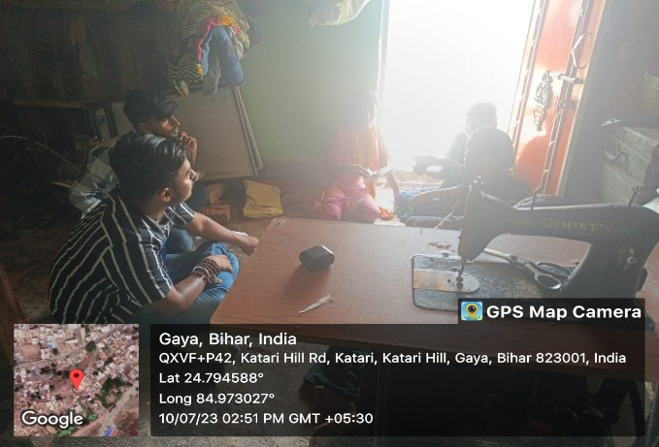
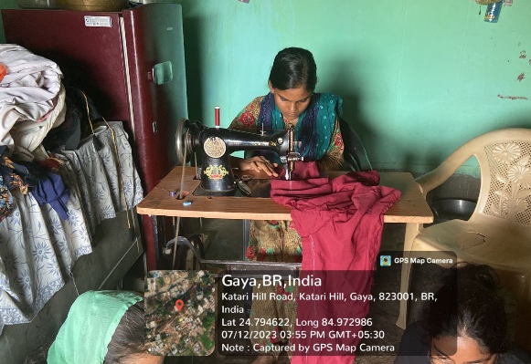
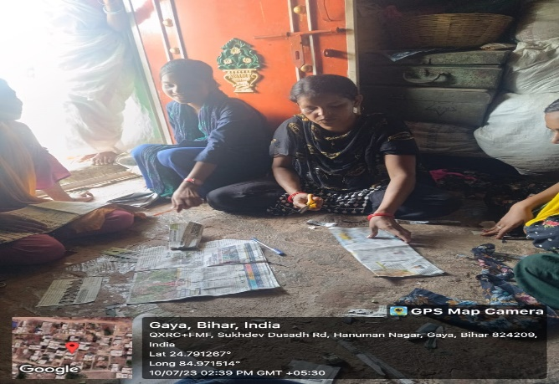
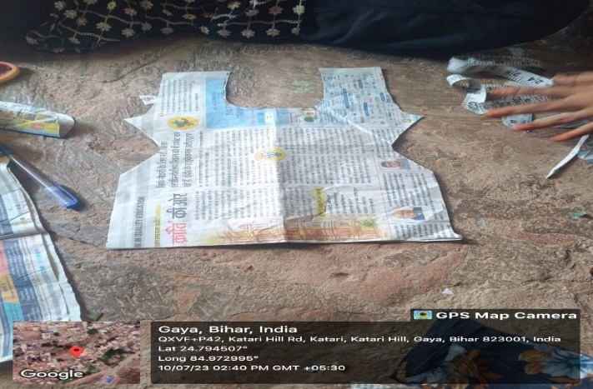
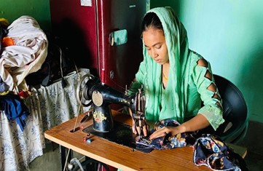
4. Main Bhi Samarth Hu
To empower women with vital skills for sustainable living. The program comprises ten days of training, emphasizing the identification and expansion of local businesses, followed by a 90-day post-skill training period. On July 10, 2023, we revisited Katari Hill to better understand the ongoing initiative’s progress. Shabnam Ji, our sewing instructor, provided a detailed description of the procedure.

Slide 11
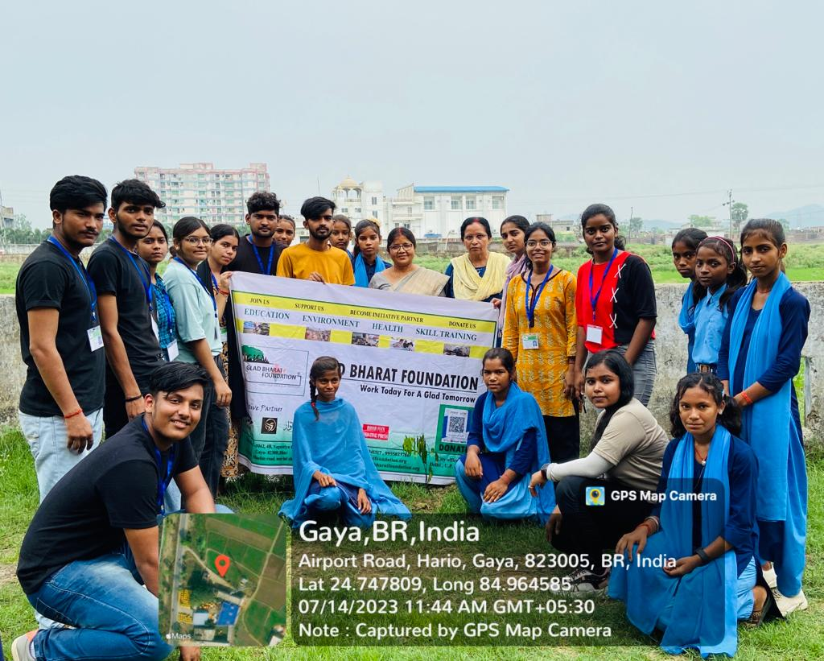

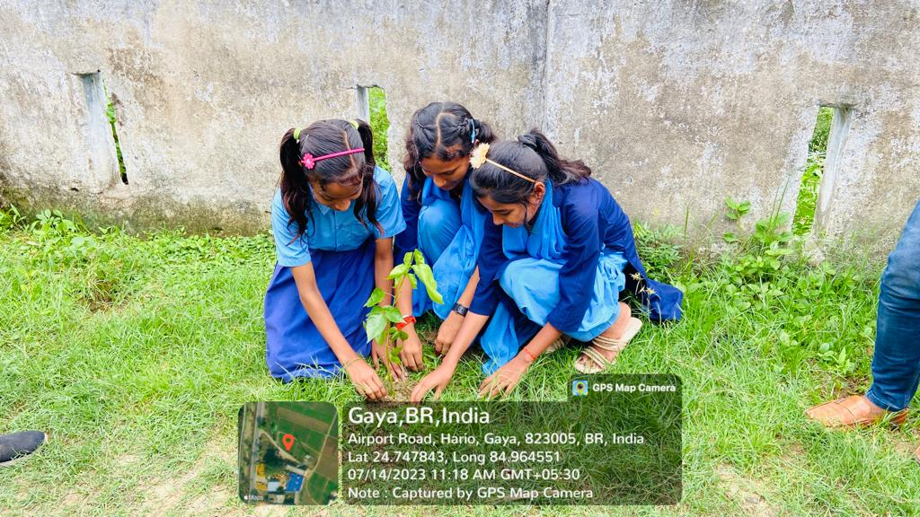
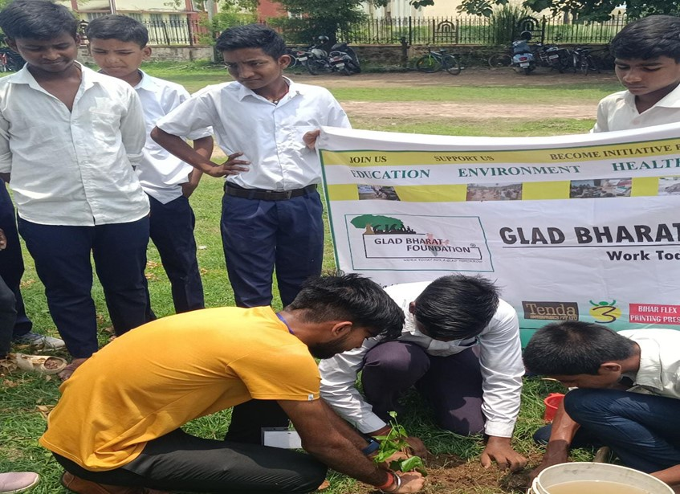
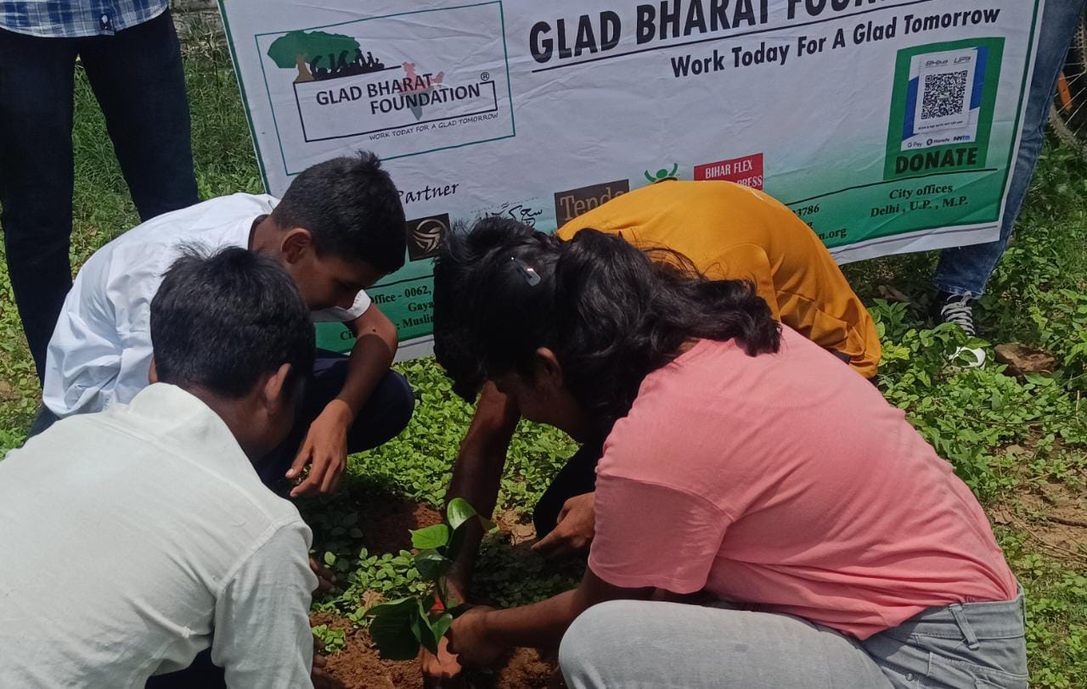
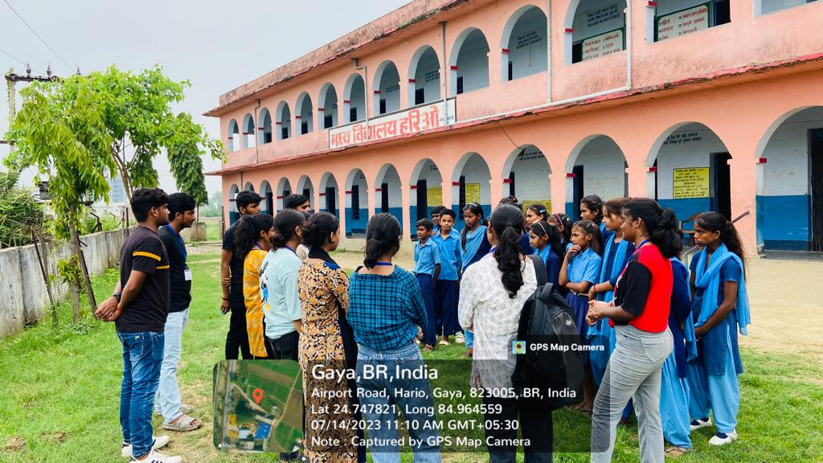
5. Green Campus
As the campus turns green, students and the school administration organize planting drives and prioritize its protection. The organization offers resources in the form of saplings, offers planting instruction, and schedules regular seminars on protecting saplings so they may develop into trees.
During our visits to +2 High School Bodhgaya and Modal School Hario in Gaya on July 12 and 13, 2023, we educated students about ecology and the importance of trees in our environment, emphasizing their role in preserving the surroundings.

Slide 12
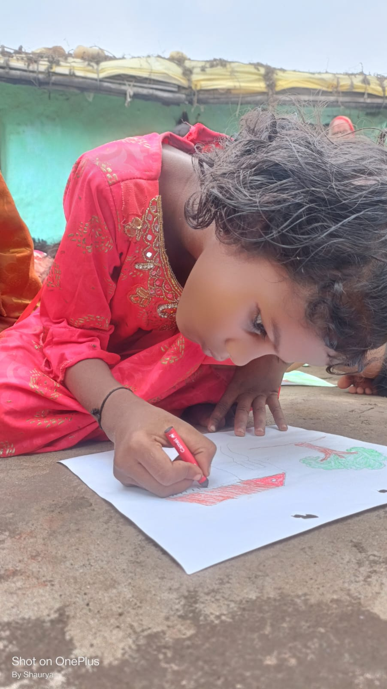
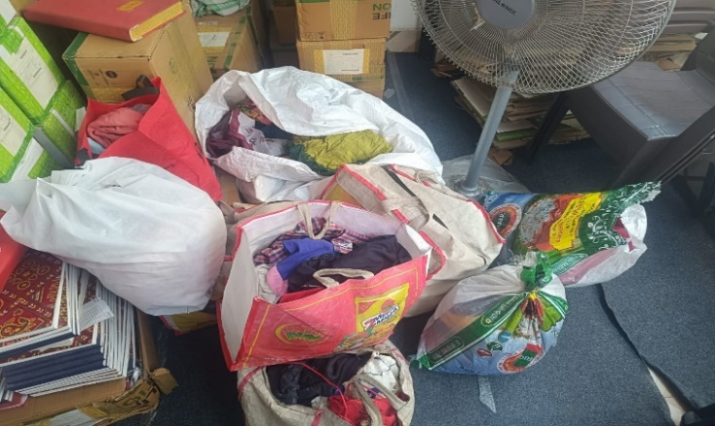
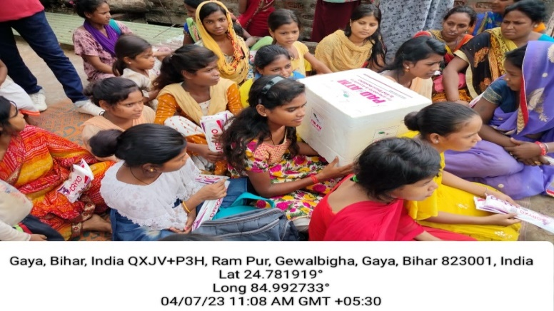

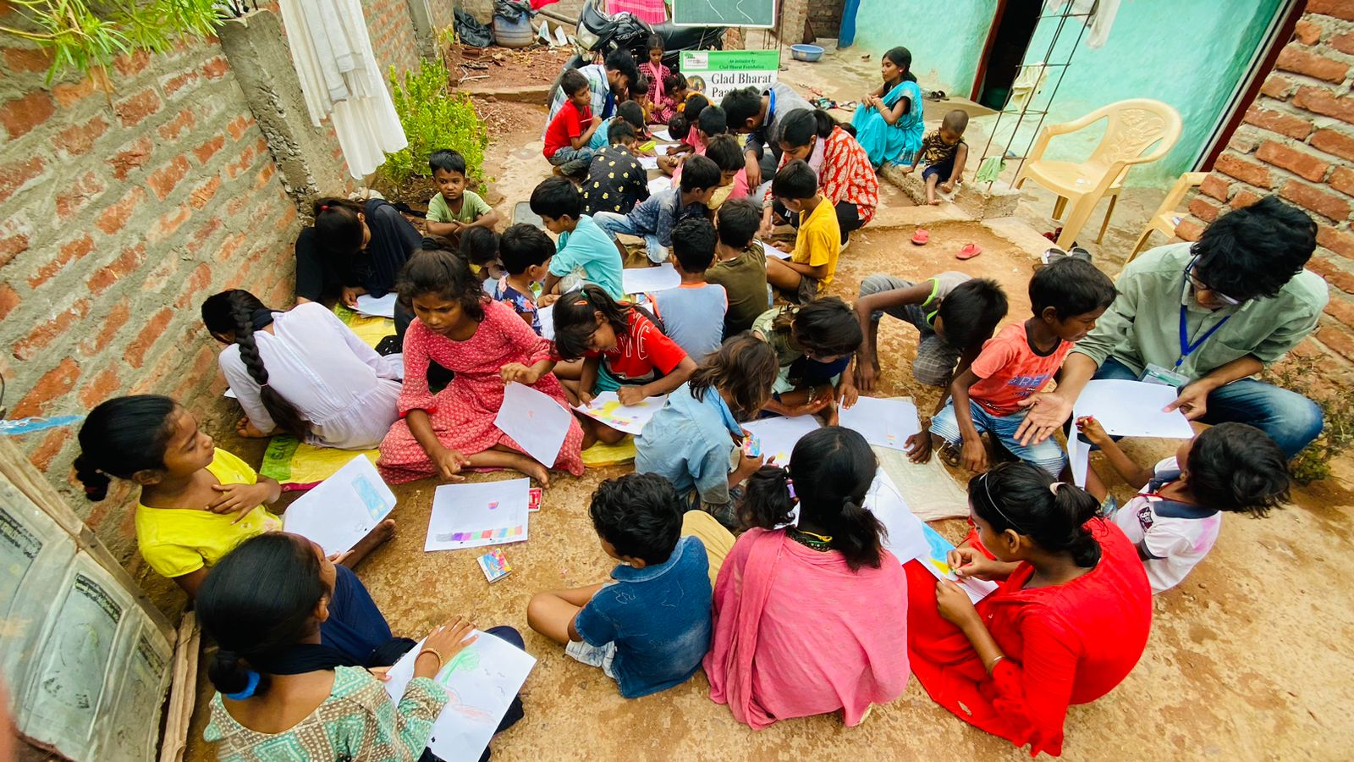

Effectiveness Of the Project
DWDB (Donate Waste Discover Best) Campaign:
Urban residents expressed keen interest in supporting the campaign.
Recognition that contributions would assist distant communities and urban slums thrive.
Glad Bharat Pathshala Initiative:
Operation in Katari Hill and Gewalbigha for a few years.
Over 80% of children in the area enrolled in school.
Local recognition of the value of education in shaping lives.
PAD-ATM (Menstrual Hygiene Project):
High success rate in providing affordable and accessible pads.
Repeated awareness programs contributing to increased understanding of menstrual hygiene among women and girls in remote areas.

Slide 13
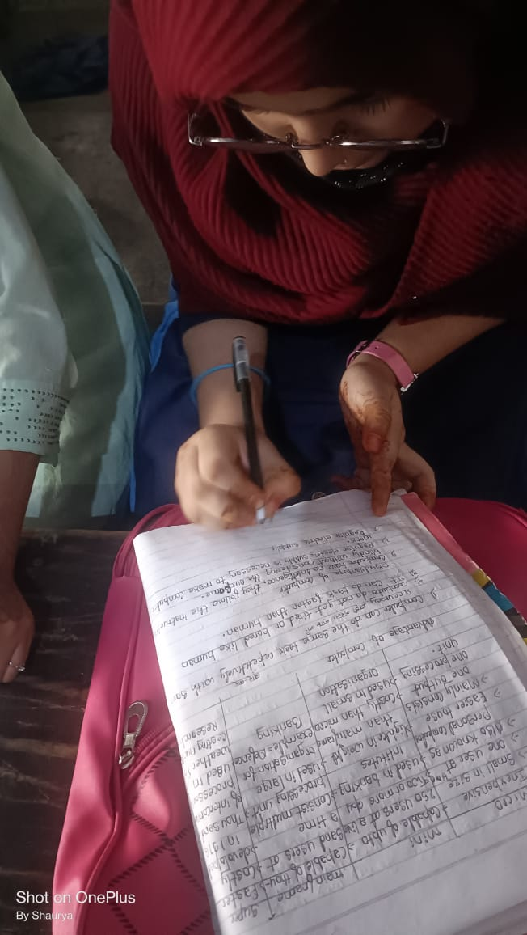
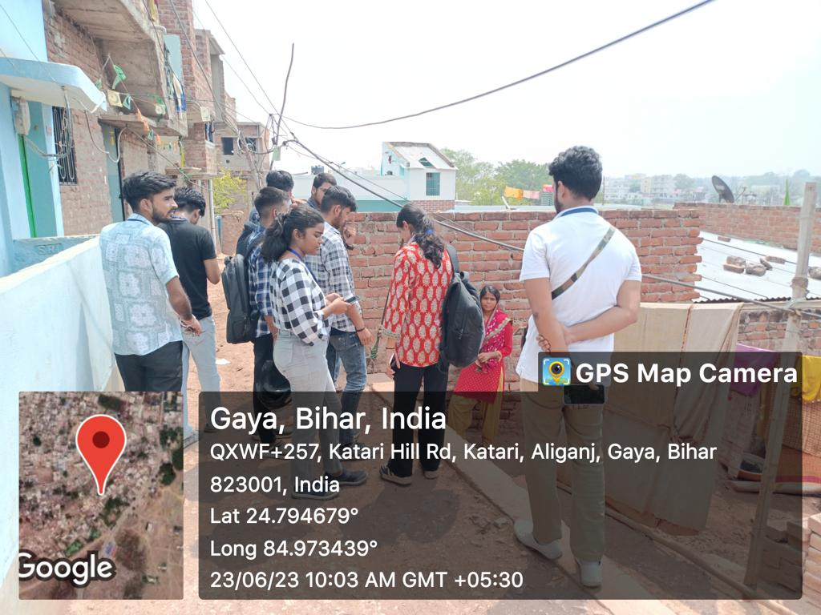
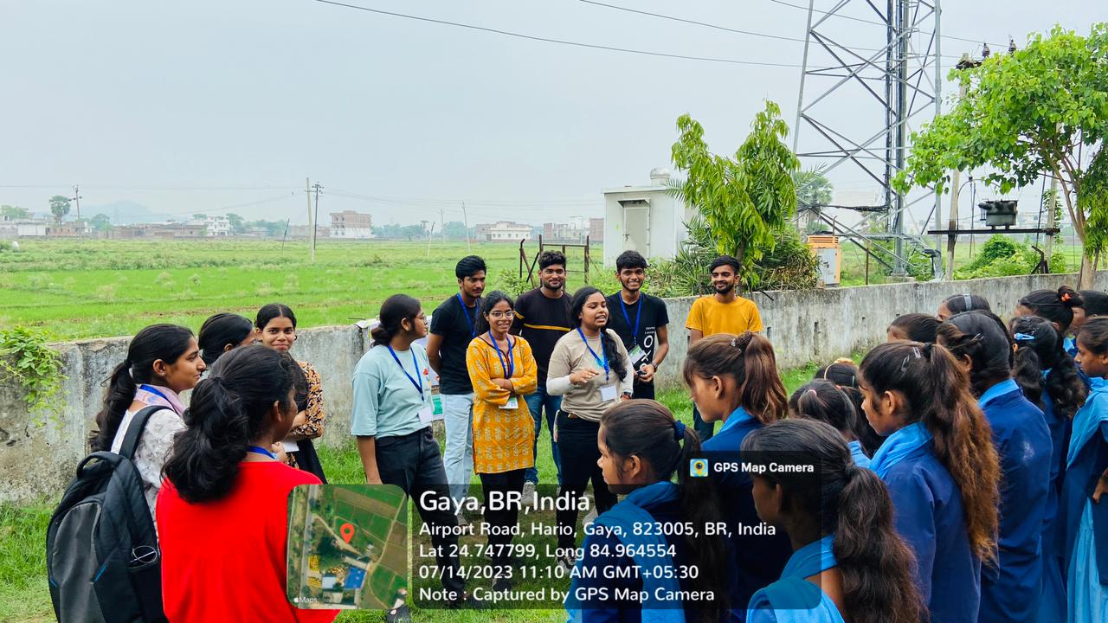
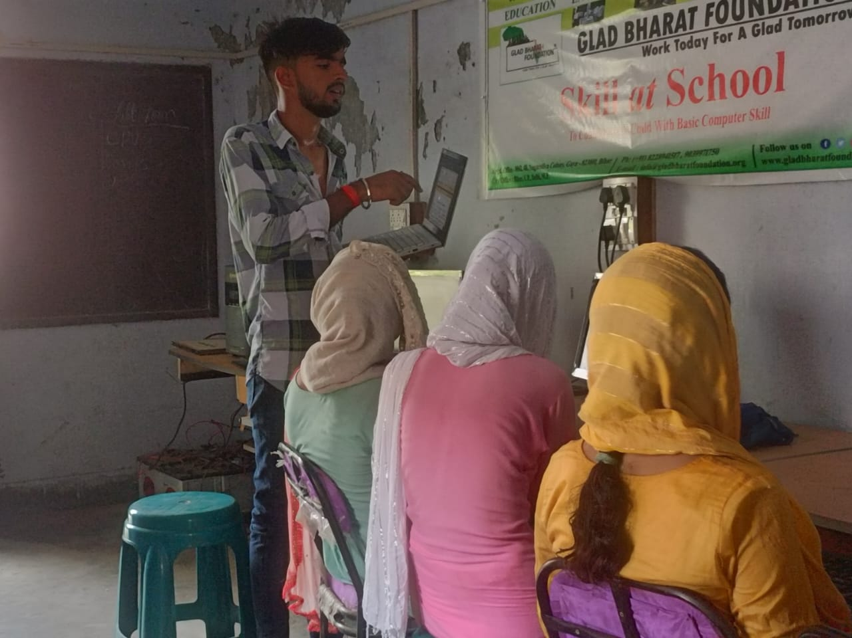
4. "Skill at School" Campaign:
Successful in cultivating interest in computer learning among kids.
Fostering respect for instructors.
Topics covered include basic of computers, the internet, basic of cyber security and Microsoft Office.
Expected positive impact on career choices and future financial support for families.
5."Main Bhi Samarth Hu" Livelihood Program:
Program success progressing positively.
2. Aimed at developing skills in mothers and daughters.
3. Focus on creating local businesses for improved financial support or education funding.

Slide 14

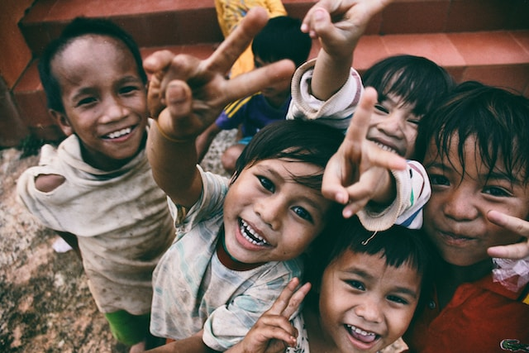
CONCLUSION
I dedicated approximately four weeks to collaborating with the Glad Bharat Foundation. During this time in my hometown, I had the opportunity to explore various sections of my community that had previously gone unnoticed by me. Whether I was interacting with local leaders, engaging with camp participants, contributing to the "Skill At School" initiative, or tending to the plants planted during the "Green Campus Camp" at Bodhgaya High School and Model School Hario (Gaya)
One of the key realizations was that while these societies aspired for progress, they lacked clear pathways to achieve it. Drawing from our own encounters, we can provide them with guidance on actionable steps to attain their goals. Moreover, I came to understand that merely focusing on their well-being and donating resources to these remote communities falls short

Slide 15
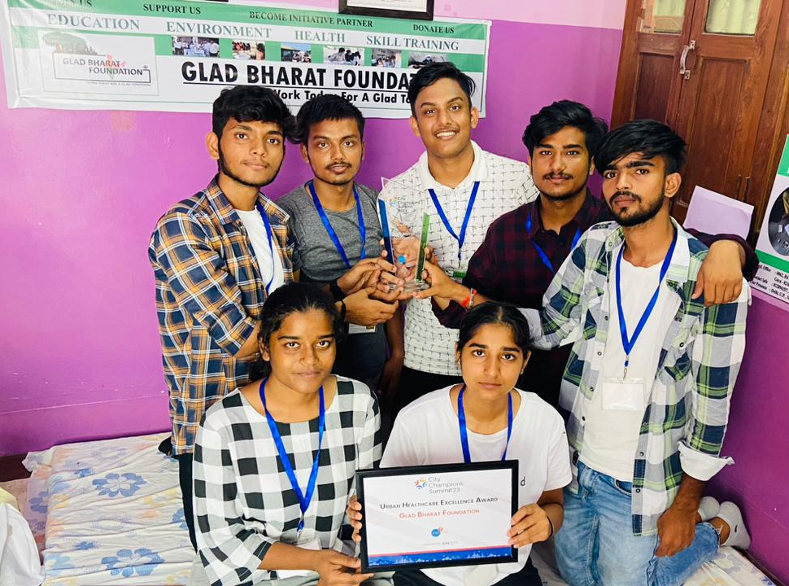
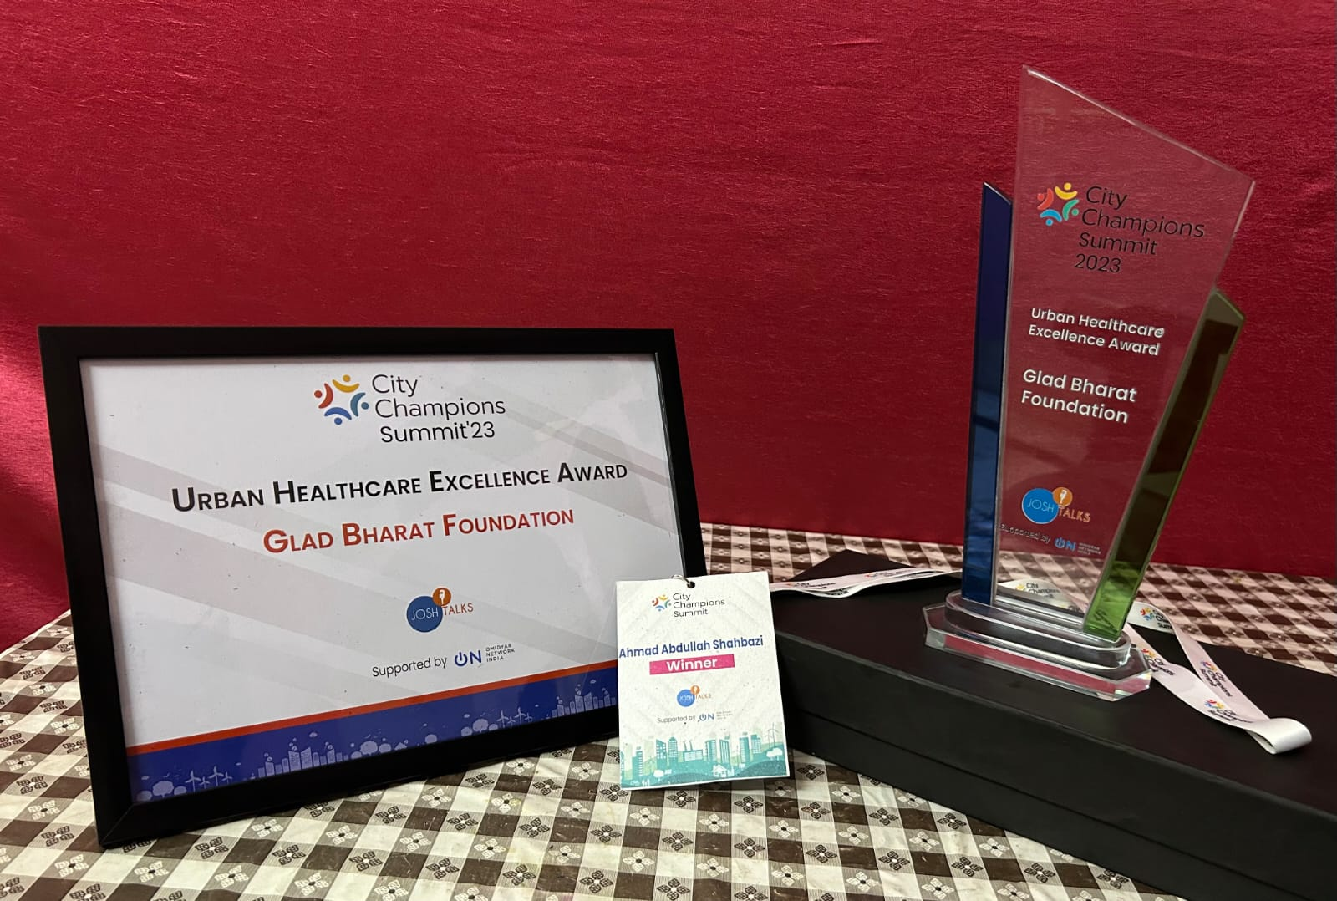
ACHIEVMENTS
The Glad Bharat Foundation, which I worked for during my internship, was informed that it had won the Urban Healthcare Excellence Award in the 2023 City Championships. As a result, on July 6, 2023, we also had the opportunity to appear in the Josh Talks documentary with our tutor Ahmad Sir.

Slide 16

THANK YOU

